Slide 1


Forecast Week 6 Results
Oct. 3 – 6, 2021
as understood by David Eduardo Morales

Slide 2
Observed flow for Forecast week 6: 178cfs
Graphs that may or may not provide insight
01
Justification for bonus points—take it or leave it
02
Some fun code
03
Best for last—rankings and points
04

Slide 3
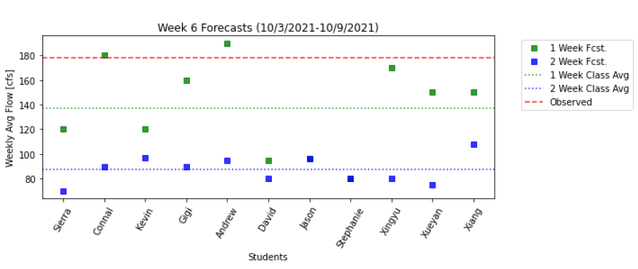
01: Graphs

Slide 4
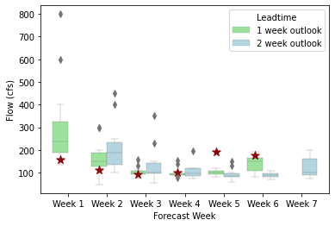
01: Graphs cont’d.

Slide 5
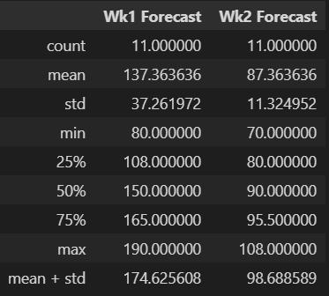
02: Justification
I took the mean and standard deviation value from each week forecast and added them together (see bottom row, “mean + std”).

Slide 6
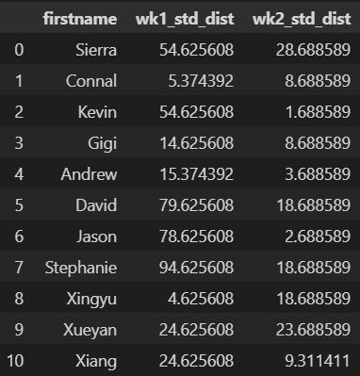
02: Justification cont’d.
I then subtracted the respective value from every students’ one-week and two-week forecasts to find the absolute value of each forecast’s distance from the standard deviation + mean value.

Slide 7
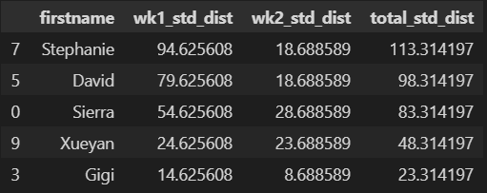
02: Justification cont’d.
I added these two values together in a new column, “total_std_dist”, dropped out the students who were already receiving points, and sorted the remaining rows in descending order.
Because I couldn’t give myself points, the top 3 received points.

Slide 8
03: Some Fun Code
# %%
# Create floop for removing students' name from df if they received points
for name in points:
index_name = std_dist_df[std_dist_df['firstname'] == name].index
std_dist_df.drop(index_name, inplace=True)
# Add column of the combined distance from weekly std to df
std_dist_df['total_std_dist'] = std_dist_df['wk1_std_dist'] + \
std_dist_df['wk2_std_dist']
# Sort dataframe to find highest combined distances
final_sort = std_dist_df.sort_values(by='total_std_dist', ascending=False)
final_sort

Slide 9
04: Rankings and Points
Scoring forecasts for week 6 : 10/3/2021 - 10/9/2021
Observed Flow = 177.857
1 Week Forecast
First Place = ['Connal'] flow forecast = [180.] Second Place = ['Xingyu'] flow forecast = [170.] Third Place = ['Andrew'] flow forecast = [190.]
2 Week Forecast
First Place = ['Xiang'] flow forecast = [108.] Second Place = ['Kevin'] flow forecast = [97.] Third Place = ['Jason'] flow forecast = [96.]

Slide 10
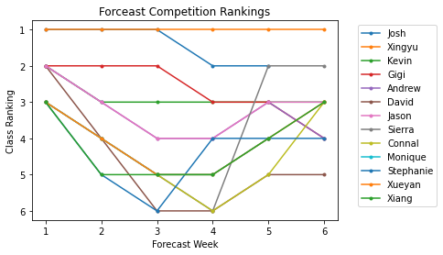
04: Rankings and Points

